Slide 1


EMPLOYEE RETENTION
HR ANALYTICS
Team Members (Group-1) :-
Kunal Rajbhar
Vandit Rajamani
Harish Kore
Seetana Sai
R Meganathan
Mohammed Shibil
Rafeeque
Muhammed Nihal KP
Mentor Name :- Srinivas and Suraj Kumar

Slide 2


TABLE OF CONTENTS
INTRODUCTION
DATASETS
PROJECT PROCESS
TOOLS USED FOR ANALYSIS
KPI’s
DASHBOARD IMAGES (EXCEL, POWER BI, TABLEAU)
INSIGHTS
RECOMMENDATIONS
CONCLUSION

Slide 3
INTRODUCTION
Overview
HR analytics involves the collection and analysis of HR-related data, including employee data, performance metrics, and other relevant data points. By using advanced analytical tools and techniques, HR analytics provides valuable insights into HR processes and trends, enabling organizations to make more informed decisions about their employees and improve overall performance.
Objective
The aim of this project is to analyze employee retention and attrition rates with the organization and provide insights to the HR team for developing effective retention strategies.

Slide 4



HR_1.xlsx
DATASETS
HR_2.xlsx
Data Description
Total Records: 50,000 employees.
Key Variables: Age, Gender, Department, Job Role, Monthly Income, Attrition , Years Since Last Promotion, Work-Life Balance, Job Involvement.

Slide 5





PROJECT PROCESS
01
02
03
04
Data Extraction
Transformation
Data Analysis
Dashboard
The data was extracted from HR information systems and combined into a single dataset for analysis.
Steps included removing duplicates, handling missing values, and standardizing data formats.
Various statistical methods and visualizations were employed to understand the data distribution and identify trends.
An interactive dashboard was created to present findings and key insights.
Design layout for clarity and impact.

Slide 6





TOOLS USED FOR ANALYSIS
EXCEL
MySQL
Tableau
POWER BI

Slide 7

KEY PERFORMANCE INDICATORS
Average Attrition rate for all Departments
Average Hourly rate of Male Research Scientist
Attrition rate Vs Monthly income stats
Average working years for each Department
Job Role Vs Work life balance
Attrition rate Vs Year since last promotion relation

Slide 8
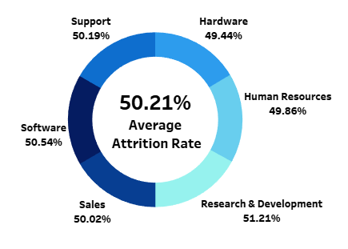
KPI 1 :- Average Attrition rate for all Departments
Description :-
The average attrition rate across all departments was calculated to provide a high-level view of employee turnover within the organization.
Visual: A donut chart illustrates the attrition rate per department.
Insight :-
Highest Attrition: Research & Development with 51.21% attrition rate.
Lowest Attrition: Hardware with 49.44% attrition rate.
Conclusion: Departments with higher technical demands, such as Research & Development, show increased attrition, likely due to stress or better opportunities elsewhere.

Slide 9
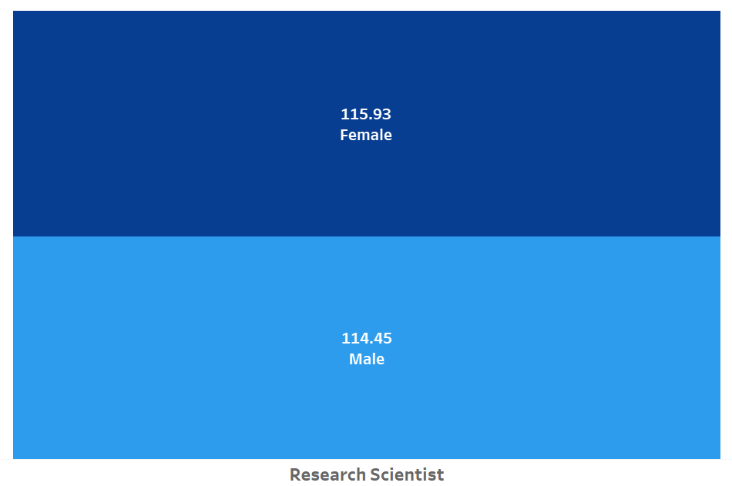
KPI 2 :- Average Hourly rate of Male Research Scientist
Insight :-
This KPI is to find out the average hourly rate of male research scientists which is 114.45.
While for female research scientist, it is 115.93.
There is a pay disparity based on gender.
Pay should be determined based on factors such as experience, qualifications and responsibilities.

Slide 10
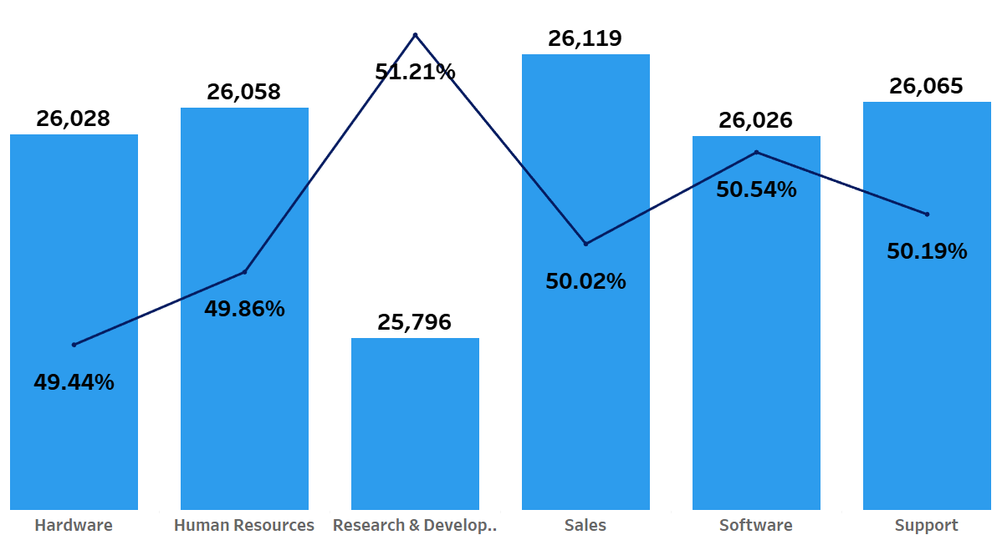
KPI 3 :- Attrition rate Vs Monthly income stats
Description :-
This analysis examines the correlation between attrition rate and monthly income across different departments, helping to understand how compensation impacts employee retention..
Visual: A line chart overlaid on a bar chart shows the attrition rate against monthly income for each department..
Insight :-
Key Observation: The Research & Development department has the highest attrition rate (51.21%) despite a relatively high average income, suggesting that factors other than compensation, such as job satisfaction or work-life balance, might be influencing turnover.

Slide 11
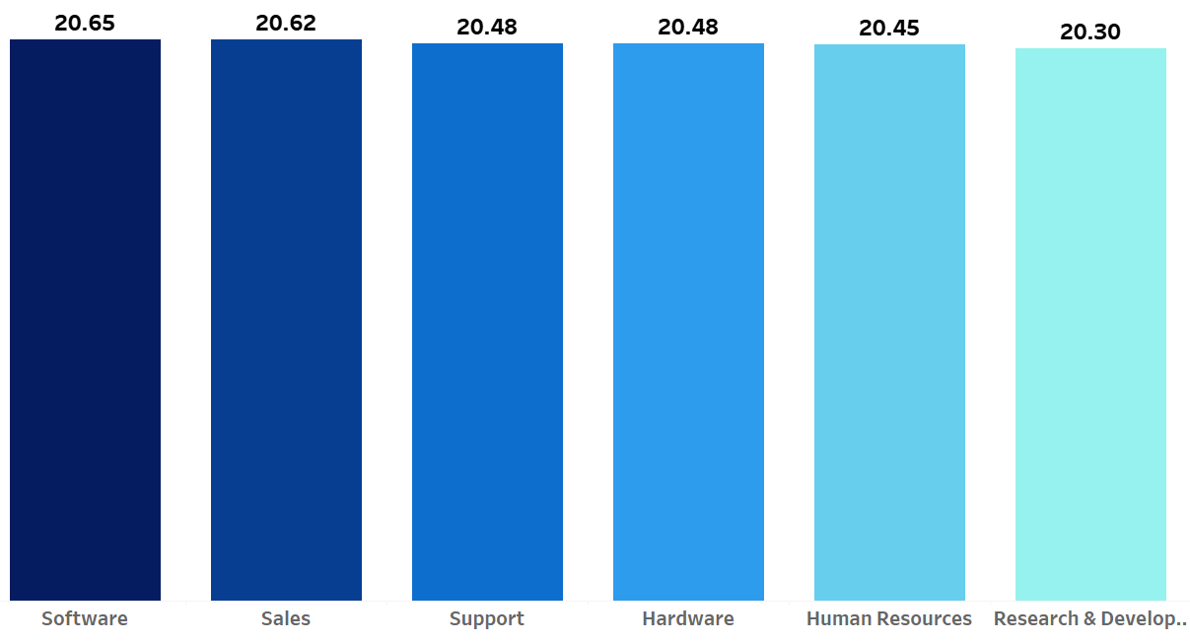
KPI 4 :- Average working years for each Department
Description :-
This metric measures the average tenure of employees within different departments, providing insights into employee loyalty and departmental stability..
Visual: A bar chart illustrates average years of service per department.
Insight :-
Employees in the Software department have the longest average tenure of 20.65 years and Employees in Human Resources have a slightly shorter average tenure of 20.45 years.
Conclusion: Departments with more technical or specialized roles tend to retain employees for longer periods, possibly due to the expertise required and the investment in training..

Slide 12
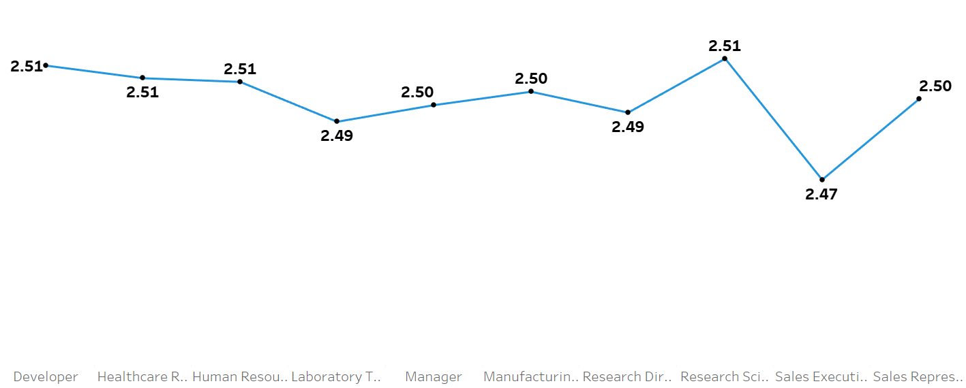
KPI 5 :- Job Role Vs Work life balance
Description :-
This metric examines the relationship between different job roles and their respective work-life balance scores..
Visual: A line chart represents the average work-life balance score across various job roles.
Insight :-
Observation: Research Scientists and Sales Representatives report the best work-life balance with scores of 2.51.
Lowest Scores: Manufacturing Directors have the lowest score of 2.47, indicating potential issues with work-life balance in this role.

Slide 13
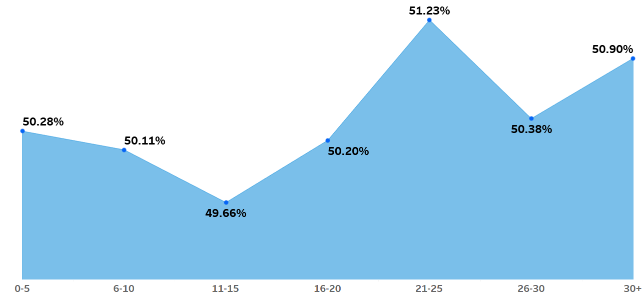
KPI 6 :- Attrition rate Vs Year since last promotion relation
Description :-
This metric explores the relationship between the number of years since an employee’s last promotion and the attrition rate.
Visual: A line chart displays the attrition rate across different time periods since the last promotion.
Insight :-
Highest Attrition: Employees with 21-25 years since their last promotion have the highest attrition rate at 51.23%.
Lowest Attrition: Employees who have been promoted within the last 6-10 years have the lowest attrition rate at 49.66%.

Slide 14
DASHBOARD IMAGES

Slide 15
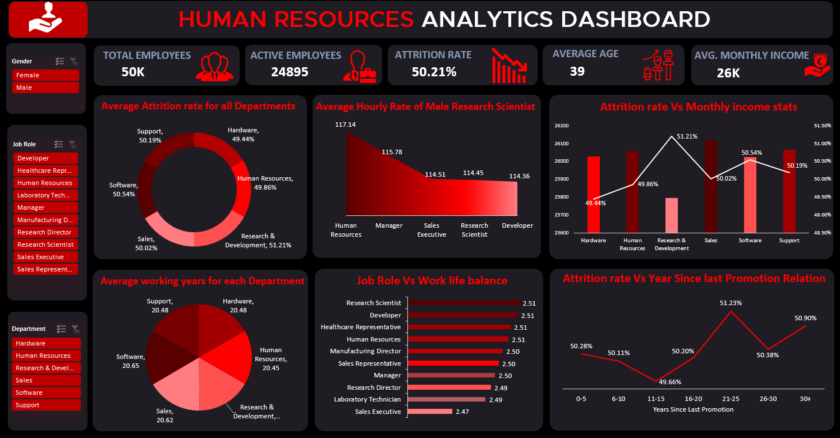
EXCEL DASHBOARD

Slide 16
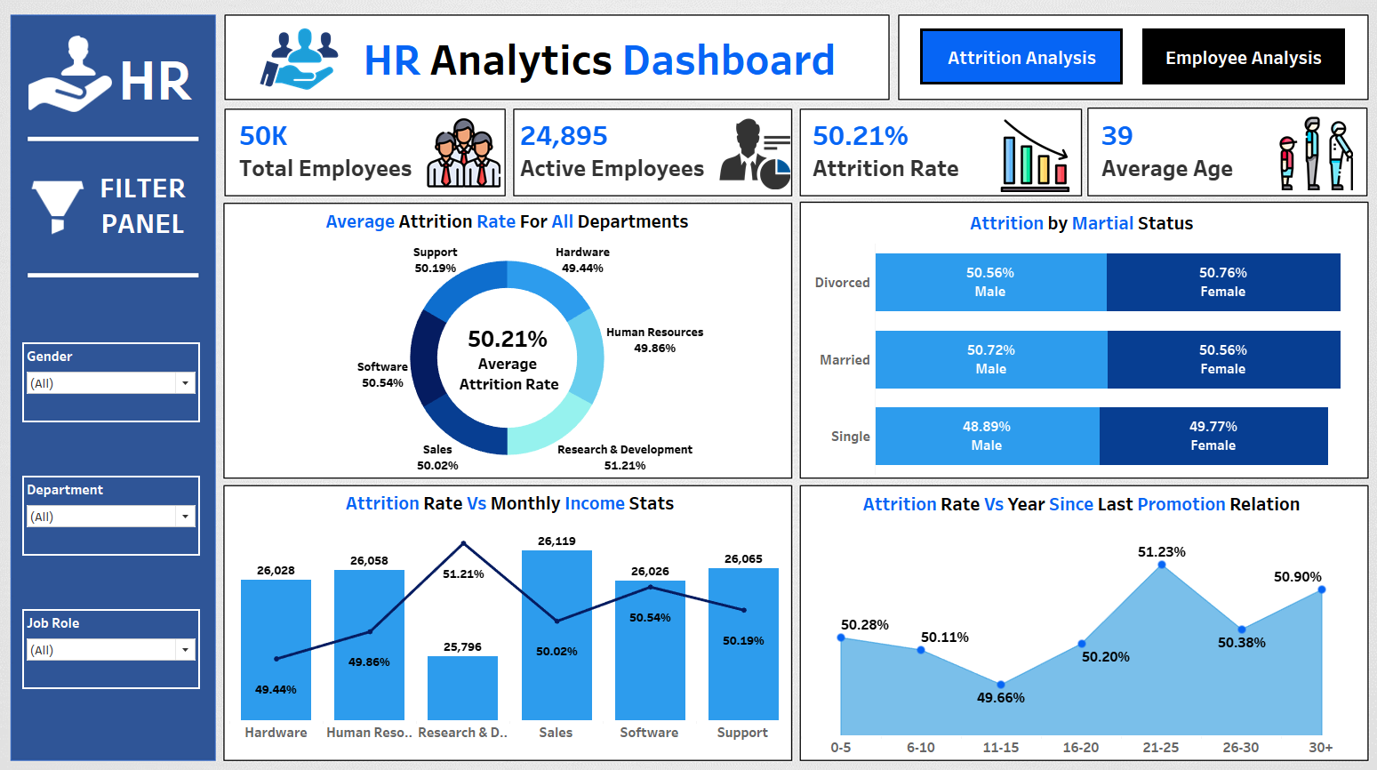
TABLEAU DASHBOARD PAGE - 1

Slide 17
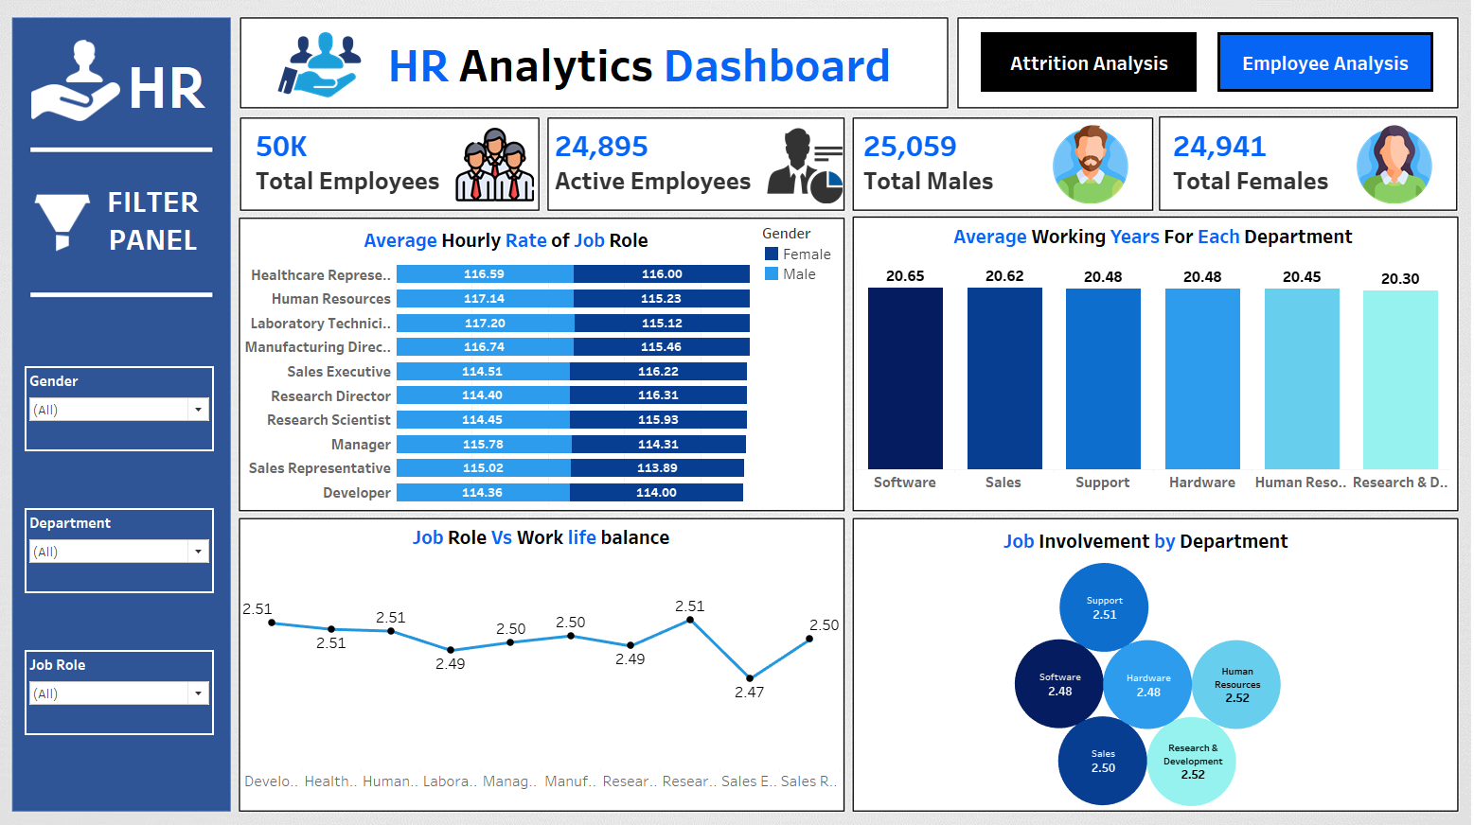
TABLEAU DASHBOARD PAGE - 2

Slide 18
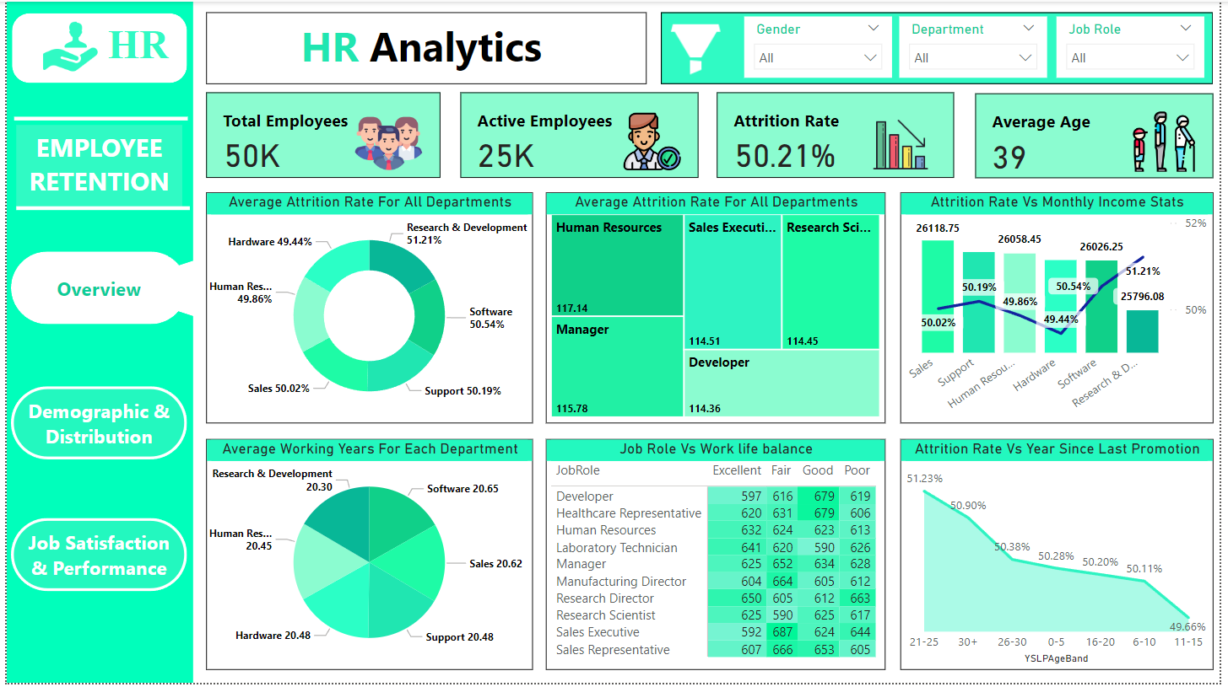
POWERBI DASHBOARD PAGE - 1

Slide 19
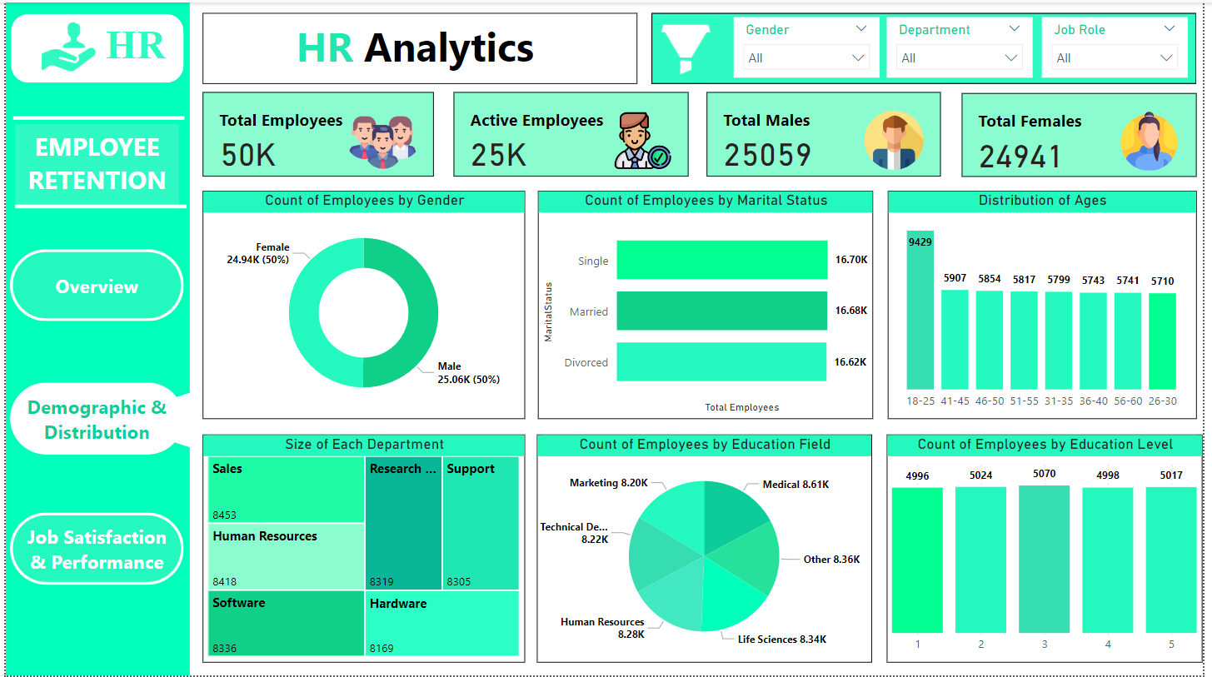
POWERBI DASHBOARD PAGE - 2

Slide 20
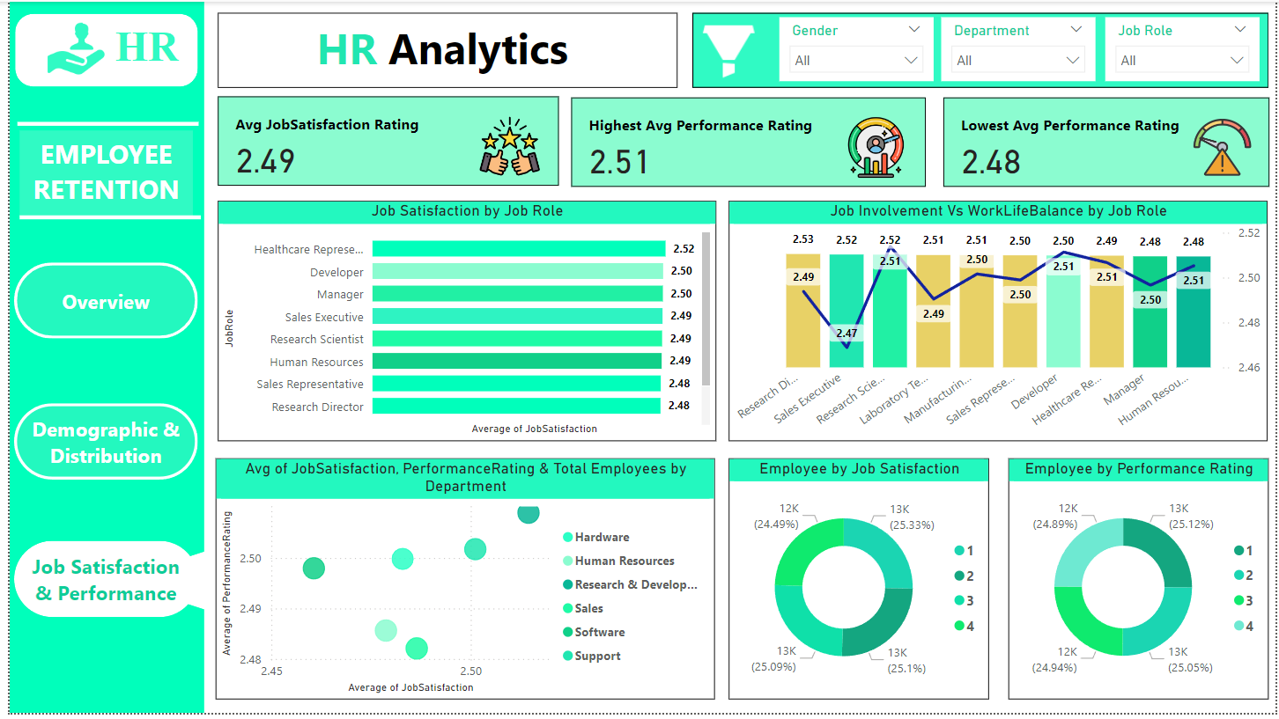
POWERBI DASHBOARD PAGE - 3

Slide 21

Research & Development has the highest attrition rate, despite competitive compensation, likely due to high job demands.
Job roles with the best work-life balance, like Research Scientists, show better retention, emphasizing the importance of work-life balance initiatives.
Career progression is crucial, as employees who have not been promoted in over 20 years are at high risk of leaving.
INSIGHTS

Slide 22
RECOMMENDATIONS
Conduct stay interviews: Instead of exit interviews, conduct stay interviews with employees to gather feedback about the job.
Improve employee engagement: Implement initiatives to improve employee engagement, such as regular feedback, recognition and rewards programs, and opportunities for career growth.
Address workload issues: Ensure employees have manageable workloads by regularly monitoring and adjusting workloads to prevent burnout and overwhelm.
Address pay and compensation issues: Ensure that employees receive fair pay and compensation for their work and to find out what motivates an employee to continue to work in an organization.

Slide 23

CONCLUSION
The data indicates that there are areas of concern regarding job satisfaction within the organization. Employees may be experiencing challenges or dissatisfaction with certain aspects of work environment.
Engaging in this project has been a valuable opportunity for skill development and refinement. We have strengthened our proficiency in Excel, Tableau, Power BI, SQL and Data Analysis.

Slide 24

THANK YOU
Team Members (Group-1) :-
Kunal Rajbhar
Vandit Rajamani
Harish Kore
Seetana Sai
R Meganathan
Mohammed Shibil
Rafeeque
Muhammed Nihal KP

